Slide 1
Fintech Group Project 01
Azuki, BAYC and Crypto Punks NFTs.
by Angel, Chris & Meek, 2022
Notes:
Afro Radio, LLC was started by Meek Msaki in May 2020. This is an introduction to the organization of Afro Radio as of 2020.

Slide 2


Table of Contents
Hypothesis of Project
Data Collection
Data Cleanup & Exploration
Data Analysis
Discussion
Postmortem
Your Questions?
Azuki Token ID: 7558 | Current Owner: ron1n.eth | Sale: 27ETH
Notes:
Afro Radio is simply put a media organization. I like simple ideas. All I am doing with Afro Radio is this. I am using media platforms to give a voice to the unheard. Doesn't matter what's in question. Afro Radio expresses itself through photography, talk shows, news articles, weekly & monthly journals and music. Simple ideas. Simple media.

Slide 3
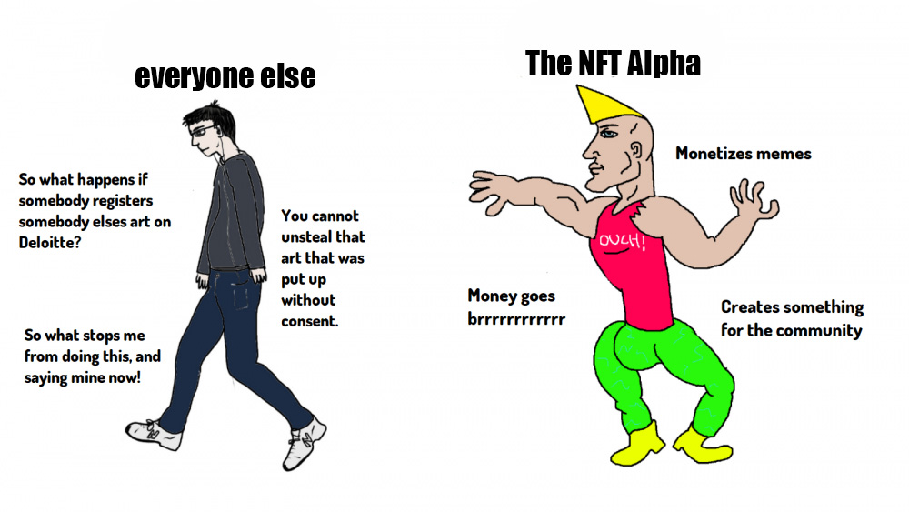

Slide 4
1. Hypothesis
Notes:
Now. What does Afro Radio have to do with Africa? Can someone explain. I will give you a gift if you get it right. Anyone?

Slide 5
Hypothesis of Project
Our motivation and summary…
Should you invest in Azuki, BAYC or Crypto Punks?
How can you tell which collection is performing well?
Notes:
The word "Afro" is used to describe a specific hair style. Afro Radio is not a radio station about afros. In fact, the owner is bald. Some of the members of Afro Radio are Africans. Our Organization represents people of all races. It is important to know that we are not affiliated with any African Organizations. Afro Radio is based in Minneapolis, Minnesota. I am proud of Africa. I am proud to be a black man in America. Yes, Afro Radio will launch a radio station. However, that's not all we are about.

Slide 6

Data Collection
Describing what kinds of data we needed and where to find it.

Slide 7
2. Data Collection
Collecting data for NFT Collections
Notes:
As I said. We are specialized in media production. We have several media channels. Who can take a guess what these channels are?

Slide 8
Covalent API
Etherscan Python Dependacy
Notes:
Okay. We are everywhere, just like you'd expect.

Slide 9
3. Data Cleanup & Exploration
Exploring our collection data through APIs preparing it for analysis
Notes:
Search Afro Radio on Apple News. You will find our publications on this platform every Friday.

Slide 10
4. Data Analysis
Analyzing our data and developing figures to answer our questions
Notes:
We run a 24/7 online radio station available on tune in

Slide 11
5. Discussion
Combining our data and discussing our findings
Notes:
Afro Radio will have Bi-Weekly podcasts on Apple Podcasts on it's various shows. Some shows are bi-weekly.

Slide 12
Postmodern
Did we find everything we expected to find?
Our ifficulties and how we dealt with them
Additional questions that came up but didn’t answer
What would we research Next?
Notes:
At the moment there are two podcasts representing Afro Radio. The N word podcast by Meek Msaki. Big Jue Podcast by Calyster Jallah. Tune in to the talk shows to know about the hosts and their hosts.

Slide 13
Postmoterm
Difficulties that arose
Our difficulties and how we dealt with them
Additional questions that came up that we didn’t answer
What would we research next if we had more time?

Slide 14
8. Questions
Open floor Q&A with the audience
Notes:
There is one YouTube channel representing Afro Radio. Search Afro Radio on youtube. There is nothing on there.

Slide 15

thank you,
Notes:
That's all folks. Thank you,

